Slide 1
HR Connections
December 2022

Slide 2
Agenda
Upcoming Legal Holidays
University Staff Year-End Leave Use and Banking
NEW: Data Request Form (BP Logix)
ePerformance Timeline/Reminders
Pay Plan Reminder
Spring Employee Essentials

Slide 3
Upcoming Legal Holidays
December 24th (Saturday)
Earn one day of floating holiday
US – must use prior to December 31, 2022 (can be used prior to Dec. 24)
AS/LI – must use prior to June 30, 2023
FA/IAS on academic year contracts do not earn floating holiday
8 hours for full-time (prorated based on FTE for less than full-time)
December 25th (Sunday)
Observed on Monday, December 26th
Automatically entered as "Legal Holiday" for full-time staff (1.0 FTE) and all exempt FA/AS/LI staff regardless of FTE
Part-time US may need to enter LH based on hours typically worked/FTE

Slide 4
Upcoming Legal Holidays
December 31st (Saturday)
Earn one day of floating holiday
US – must use prior to December 31, 2022
AS – must use prior to June 30, 2023
FA/IAS on academic year contracts do not earn floating holiday
8 hours for full-time (prorated based on FTE for less than full-time)
January 1st (Sunday)
Observed on Monday, January 2nd
Automatically entered as "Legal Holiday" for full-time staff (1.0 FTE) and all exempt FA/AS/LI staff regardless of FTE
Part-time US may need to enter LH based on hours typically worked/FTE

Slide 5
University Staff Leave Reminder
All current vacation carryover and personal holiday balances – use by December 31, 2022
Calendar year 2022 vacation allocation becomes vacation carryover on January 1st, 2023
Personal holiday reallocated each year, no carryover
AS/FA/LI = fiscal year leave earners, leave use reminders will be given in Spring

Slide 6
University Staff Leave Banking
Eligible US employees received email first week of December from UW Shared-Services
Deadline to bank: December 31, 2022
Review portal article or contact payroll@uwss.wisconsin.edu with questions
https://uwservice.wisconsin.edu/news/post/757

Slide 7
W2 Reminders
Electronic only consent – W2's will be available in your UW System portal in late January
Paper distribution – those that have elected paper distribution – ensure address is up to date – mailed in late January
Tip sheet:
https://uwservice.wisconsin.edu/docs/publications/w2-1095-electronic-consent.pdf

Slide 8
Questions?
Contact the payroll shared services team at payroll@uwss.wisconsin.edu
Tip-sheets/Guides for absence entry (including Legal Holiday): https://uwservice.wisconsin.edu/help/time-absence/

Slide 9
NEW: Data Request Form (BP Logix)
Rolled out today
Purpose: for departments to request specific HR data for certain projects, surveys, and other important tasks that cannot be typically obtained within their unit or division.
Demo in BP Logix
Notes:
Old data request form (paper) will be deactivated once BP Logix is rolled out – linked in the Forms Library under BP Logix

Slide 10
Data Requests
When is it appropriate to request HR data:
When you cannot receive the data by College or division UBO
Need information about data stored within HRS for job-related data projects, surveys, etc.
Other means of obtaining HR data:
College or division UBO
Notes:
Must be a proper business reason for the requested data
Will go through HR approval process to confirm request is reasonable.

Slide 11
Performance Management – Year End Activity
All employees must have a 2022 Annual Evaluation completed in ePerformance
Same process for all staff members

Slide 12
Performance Management – LI/PAS/US
Define Criteria
3/1/22
Mid-Year Checkpoint
6/1/22
Finalize Criteria
11/1/22
Self-Evaluation
1/1/23
Manager Evaluation
3/1/23

Slide 13
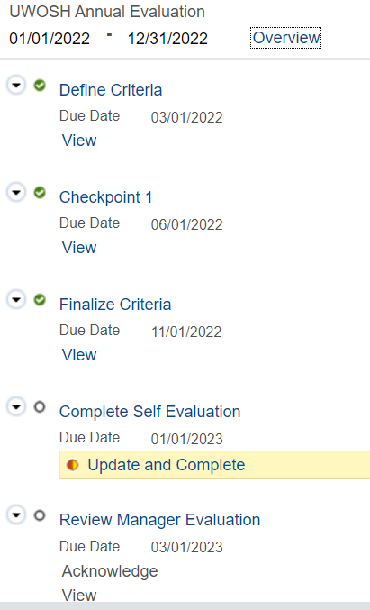
Performance Management – LI/PAS/US
How to tell what step your evaluation is in:
In order to begin the self-eval and manager eval, the "Finalize Criteria" step must be completed (green circle)

Slide 14
Performance Management – LI/PAS/US
Self-Evaluation – DUE 1/1/23
All employees must complete a self-evaluation and add comments to their goals
Manager Evaluation – DUE 3/1/23
Manager must add their own comments and ratings
EE and MGR should be meeting in Jan or Feb
Employee signs the eval after the meeting

Slide 15
Performance Management – Faculty
Rating provided by dept chair in 3 categories:
Teaching
Scholarship / Creative Activities
Service
Select the Overall Rating
Share for Employee Acknowledgement
Based on performance in 2022 calendar year
Due by March 1, 2023

Slide 16
Performance Management – IAS
Rating provided by dept chair in 3 categories:
Teaching
Professional Activities (if applicable)
Service (if applicable)
Select the Overall Rating
Share for Employee Acknowledgement
Based on performance in 2022 calendar year
Due by March 1, 2023
*If IAS is one semester only contract, see website for add’l guidance

Slide 17
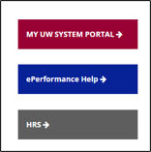
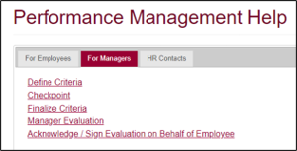
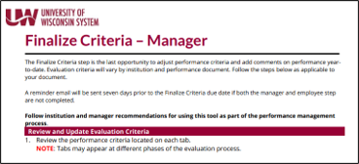
ePerformance help: https://uwosh.edu/hr/eperformance/

Slide 18
ePerformance Tips & Reminders
Make sure you select the right document when you login via the My UW System portal (look at the Period Begin/End range)
Let HR know ASAP if there are manager changes
Save often or you will lose your work if you timeout
Supervisors must complete all evals to be eligible for pay plan

Slide 19
Pay Plan Reminder
The 2nd installment of the 21-23 Pay Plan will be awarded in January:
Effective Date of Increase: 1/1/23
First Check with New Rate: 1/26/23
Eligibility criteria are located: https://uwosh.edu/hr/policies-procedures/pay-plan/
NEW: Pay plan letters will come from System this year

Slide 20
Employee Essentials – Spring Lineup!
Topic | Date
Healthy Titans = Happy Titans: Employee Wellness Opportunities at UWO (NEW) | 1/18/2023
Marketing & Branding on Campus | 2/1/2023
Waste and Procurement Sustainability | 2/15/2023
Student Employment Done Right! | 3/1/2023
Safety in the Workplace | 3/15/2023
Hosting Events with Youth Protection in Mind (NEW) | 3/29/2023
Diversity, Equity & Inclusion in the Workplace | 4/12/2023
Recruiting: Navigating the Search Process | 4/26/2023

Slide 21
Employee Essentials – Why YOU Should Attend
100% of participants report being satisfied with the presentations and learning something new
Promotes awareness of compliance and culture
Meet subject-matter-experts, ask questions and grow your internal network
Join us this spring using the Upcoming Events calendar
on the HR website!

Slide 22
Questions?
Thank you for attending!

